Slide 1

Live Coding
Python et Machine Learning

Slide 2

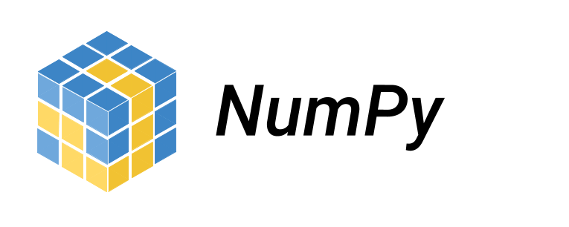


Python et la data science
https://pandas.pydata.org/pandas-docs/stable/
https://numpy.org/doc/
https://matplotlib.org/
https://scikit-learn.org/stable/

